Slide 1

Cluster Analysis by Dr Lalit Prasad

Slide 2
Outline
What is Cluster Analysis?
Types of Cluster Analysis.
Objectives of Cluster Analysis
Assumptions of Cluster Analysis
A Case Study : Cluster Analysis

Slide 3
What is Cluster Analysis ?
Cluster Analysis or Clustering is the task of grouping a set of objects in such a way that objects in the same group (Known as cluster) are more similar (in some sense) to each other than those of the other groups.
K1 K2
++ + + + + + + ++ + + + ++ + + ++ +
X X X X X X XX XX X XX XX X XX XXXX

Slide 4
Cluster Analysis vs Factor Analysis

Slide 5
Objectives of Cluster Analysis
Data Simplification
Relationship Identification
Segmentation

Slide 6
Assumptions of Cluster Analysis
Sample size Adequacy
Metric or Non metric Data
Multicollinearity

Slide 7
Research Design
Determining the measures of similarity: Squared Euclidean distance
Assessing adequacy of objects in a cluster -10% of the Sample Size
Standardization of Variables
Cluster Analysis : Demographic variables (Gender, Age, Income, Educational qualification etc) or Psychographic behaviour (Personality Traits, beliefs, values, attitudes, interests, lifestyles etc.)

Slide 8
Types of Cluster analysis
Hierarchical Cluster Analysis
Nonhierarchical Cluster Analysis ( K-Means Clustering)

Slide 9
Hierarchical Cluster Analysis(HCA)
Hierarchical Cluster analysis is a method of cluster analysis which builds a hierarchy of clusters.
There are two approaches in Hierarchical cluster Analysis
Agglomerative (Bottom up Approach)
Divisive (Top Down Approach)

Slide 10
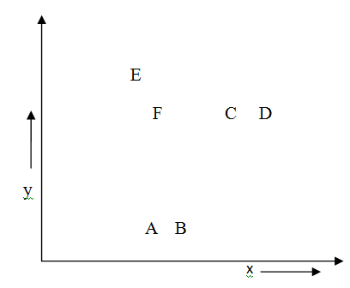
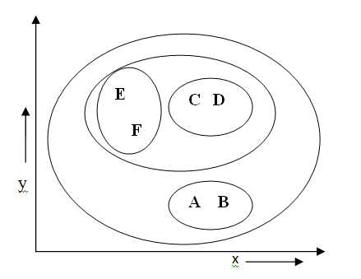
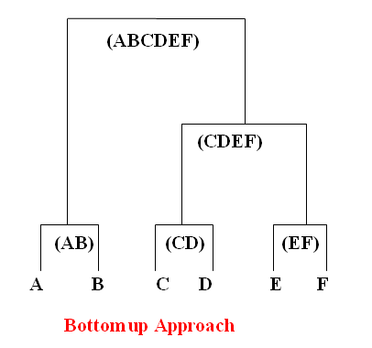
Algorithms of HCA:Agglomerative-Dendrogram

Slide 11
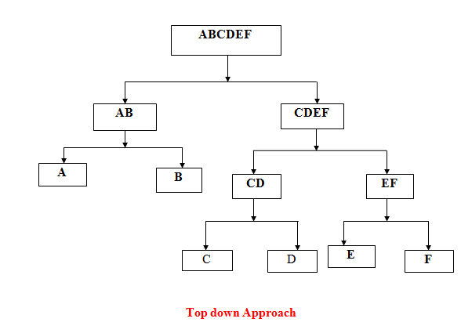
Algorithms of HCA:Divisive

Slide 12
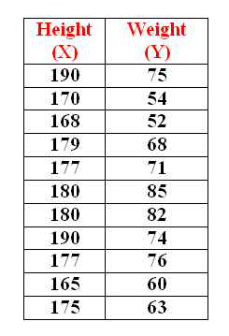
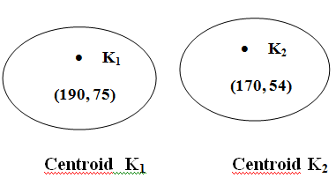
K-means Clustering
K -means clustering looks for a fixed number (k) of clusters in a data set.

Slide 13

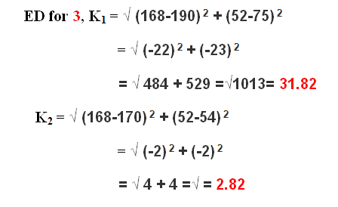



Slide 14
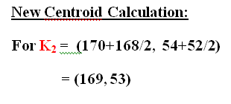
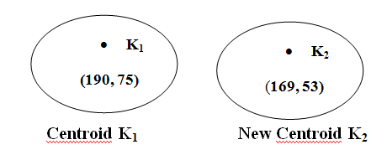
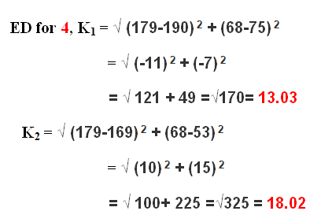


Slide 15
Case Study 1: Godrej India Ltd.
Godrej India Ltd wants to map the profile of its target customers in terms of lifestyle , attitude and perceptions. Godrej India Ltd has prepared a set of 15 statements, which according to market research team will measure many of the variables of interest. The respondent has to agree or disagree with each statement on a scale of 1 to 5.
1= Strongly Disagree, 2 =Disagree, 3= Neither Agree Nor Disagree, 4= Agree, 5= Strongly Agree

Slide 16
Topic:
A study of segmentation of customers in terms of lifestyle , attitude and perceptions.

Slide 17
Objectives
To study the variables of lifestyle, attitude and perceptions.
To segment the customers on the basis of their lifestyle, attitude and perception.

Slide 18
15 Statements
I feel foreign made products are always superior in quality.
I prefer to pay by credit card as a matter of continence.
A computer is a necessity rather than a luxury.
The liberalization of the Indian Economy has increased the efficiency of Indian Companies.
I prefer old Hindi songs than latest ones
I feel vegetarian food is more nutritious than non-vegetarian food.
I enjoy surfing on the net.
Television has become an integral part of urban life.
Women’s education is an important aspect for the overall development of the country.
A movie is a major source of entertainment.
People are more conscious about quality of product
I believe the economic status of India will improve.
I prefer readymade cloths to tailored cloths
I Prefer to take my food outside every weekend.
Basic Computer education should be included in primary education level of India

Slide 19
Data Analysis

Slide 20
Hierarchical Cluster Analysis Case Processing Summary
Case Processing Summary^{a,b}
Cases
Valid |  | Missing |  | Total
N | Percent | N | Percent | N | Percent
20 | 100.0 | 0 | .0 | 20 | 100.0
a. Squared Euclidean Distance used
b. Ward Linkage

Slide 21
Agglomeration Schedule
Agglomeration Schedule
Stage | Cluster Combined |  | Coefficients | Stage Cluster First Appears |  | Next Stage
 | Cluster 1 | Cluster 2 |  | Cluster 1 | Cluster 2
1 | 1 | 19 | 5.500 | 0 | 0 | 11
2 | 11 | 20 | 13.000 | 0 | 0 | 12
3 | 8 | 9 | 20.500 | 0 | 0 | 9
4 | 6 | 10 | 29.000 | 0 | 0 | 12
5 | 14 | 18 | 38.500 | 0 | 0 | 13
6 | 7 | 15 | 48.500 | 0 | 0 | 13
7 | 5 | 13 | 59.000 | 0 | 0 | 11
8 | 16 | 17 | 70.000 | 0 | 0 | 14
9 | 2 | 8 | 81.167 | 0 | 3 | 14
10 | 4 | 12 | 92.667 | 0 | 0 | 17
11 | 1 | 5 | 108.167 | 1 | 7 | 15
12 | 6 | 11 | 124.167 | 4 | 2 | 15
13 | 7 | 14 | 142.417 | 6 | 5 | 18
14 | 2 | 16 | 161.950 | 9 | 8 | 16
15 | 1 | 6 | 182.950 | 11 | 12 | 17
16 | 2 | 3 | 204.250 | 14 | 0 | 18
17 | 1 | 4 | 230.550 | 15 | 10 | 19
18 | 2 | 7 | 267.700 | 16 | 13 | 19
19 | 1 | 2 | 357.850 | 17 | 18 | 0

Slide 22
Cluster Membership
Cluster Membership
Case | 5 Clusters | 4 Clusters | 3 Clusters | 2 Clusters
1 | 1 | 1 | 1 | 1
2 | 2 | 2 | 2 | 2
3 | 3 | 2 | 2 | 2
4 | 4 | 3 | 1 | 1
5 | 1 | 1 | 1 | 1
6 | 1 | 1 | 1 | 1
7 | 5 | 4 | 3 | 2
8 | 2 | 2 | 2 | 2
9 | 2 | 2 | 2 | 2
10 | 1 | 1 | 1 | 1
11 | 1 | 1 | 1 | 1
12 | 4 | 3 | 1 | 1
13 | 1 | 1 | 1 | 1
14 | 5 | 4 | 3 | 2
15 | 5 | 4 | 3 | 2
16 | 2 | 2 | 2 | 2
17 | 2 | 2 | 2 | 2
18 | 5 | 4 | 3 | 2
19 | 1 | 1 | 1 | 1
20 | 1 | 1 | 1 | 1

Slide 23
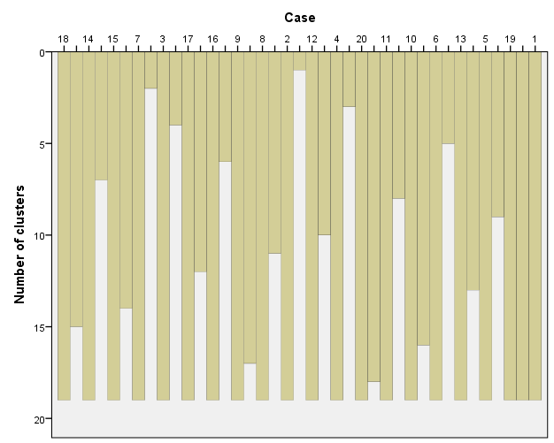
Cases

Slide 24
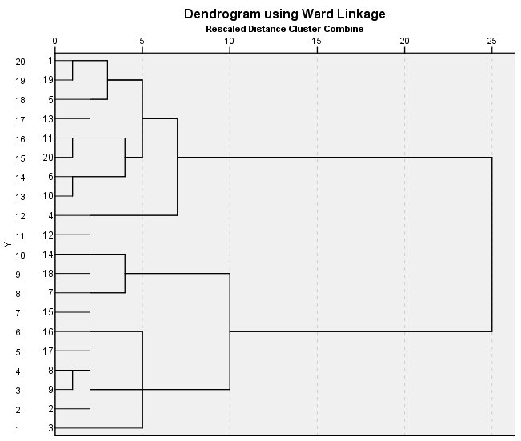
Dendrogram

Slide 25
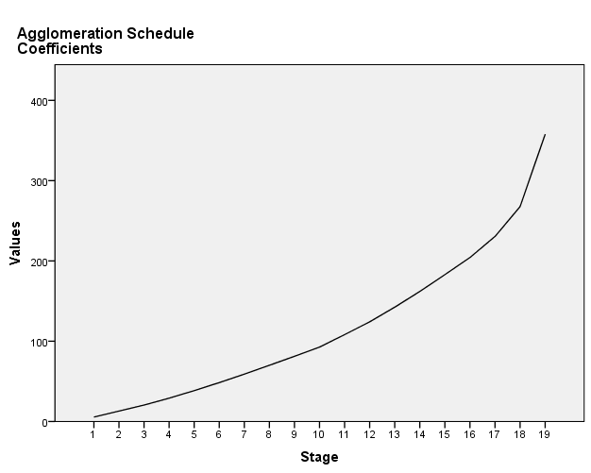
Elbow Method For Number of Clusters (No of clusters =No. of cases-elbow point

Slide 26
Non –Hierarchal Clusters Analysis (K-Means Cluster Analysis)
Initial Cluster Centers
 | Cluster
 | 1 | 2
S1 | 5 | 2
S2 | 4 | 2
S3 | 3 | 3
S4 | 4 | 3
S5 | 2 | 3
S6 | 5 | 3
S7 | 5 | 1
S8 | 3 | 4
S9 | 4 | 1
S10 | 5 | 2
S11 | 5 | 2
S12 | 5 | 4
S13 | 5 | 3
S14 | 4 | 5
S15 | 3 | 3

Slide 27
Iteration History
Iteration Historyª
Iteration | Change in Cluster Centers
 | 1 | 2
1 | 3.293 | 4.228
2 | .490 | .475
3 | .000 | .000
a. Convergence achieved due to no or small change in cluster centers. The maximum absolute coordinate change for any center is .000. The current iteration is 3. The minimum distance between initial centers is 8.307.

Slide 28
Cluster Membership
Cluster Membership
Case Number | Cluster | Distance
1 | 1 | 3.327
2 | 2 | 3.295
3 | 2 | 4.320
4 | 1 | 3.778
5 | 1 | 3.474
6 | 1 | 2.841
7 | 2 | 3.385
8 | 2 | 2.943
9 | 2 | 3.530
10 | 1 | 3.933
11 | 1 | 4.227
12 | 1 | 4.274
13 | 1 | 3.297
14 | 2 | 3.932
15 | 2 | 4.479
16 | 2 | 4.273
17 | 2 | 4.057
18 | 2 | 3.614
19 | 1 | 2.910
20 | 1 | 2.423

Slide 29
ANOVA Table
ANOVA
 | Cluster |  | Error |  | F | Sig.
 | Mean Square | df | Mean Square | df
S1 | 1.250 | 1 | 1.072 | 18 | 1.166 | .295
S2 | 11.250 | 1 | .628 | 18 | 17.920 | .000
S3 | 1.250 | 1 | 1.294 | 18 | .966 | .339
S4 | .800 | 1 | 1.344 | 18 | .595 | .450
S5 | 5.000 | 1 | 1.344 | 18 | 3.719 | .070
S6 | 16.200 | 1 | .611 | 18 | 26.509 | .000
S7 | .450 | 1 | 1.228 | 18 | .367 | .552
S8 | .800 | 1 | 1.300 | 18 | .615 | .443
S9 | 5.000 | 1 | 1.044 | 18 | 4.787 | .042
S10 | 1.250 | 1 | .961 | 18 | 1.301 | .269
S11 | 28.800 | 1 | .833 | 18 | 34.560 | .000
S12 | 4.050 | 1 | .806 | 18 | 5.028 | .038
S13 | .800 | 1 | .500 | 18 | 1.600 | .222
S14 | .450 | 1 | .739 | 18 | .609 | .445
S15 | 12.800 | 1 | 1.167 | 18 | 10.971 | .004
The F tests should be used only for descriptive purposes because the clusters have been chosen to maximize the differences among cases in different clusters. The observed significance levels are not corrected for this and thus cannot be interpreted as tests of the hypothesis that the cluster means are equal.

Slide 30
Final Clusters
Final Cluster Centers
 | Cluster
 | 1 | 2
S1 | 4 | 3
S2 | 4 | 2
S3 | 4 | 3
S4 | 4 | 3
S5 | 4 | 3
S6 | 4 | 2
S7 | 4 | 4
S8 | 4 | 3
S9 | 4 | 3
S10 | 4 | 3
S11 | 4 | 2
S12 | 4 | 3
S13 | 4 | 4
S14 | 4 | 4
S15 | 4 | 2
Final Cluster Centers
 | Cluster
 | 1 | 2
S1 | 3.90 | 3.40
S2 | 3.90 | 2.40
S3 | 3.60 | 3.10
S4 | 3.70 | 3.30
S5 | 3.70 | 2.70
S6 | 4.10 | 2.30
S7 | 4.00 | 3.70
S8 | 3.50 | 3.10
S9 | 3.60 | 2.60
S10 | 3.90 | 3.40
S11 | 4.10 | 1.70
S12 | 4.10 | 3.20
S13 | 4.30 | 3.90
S14 | 3.60 | 3.90
S15 | 3.90 | 2.30

Slide 31
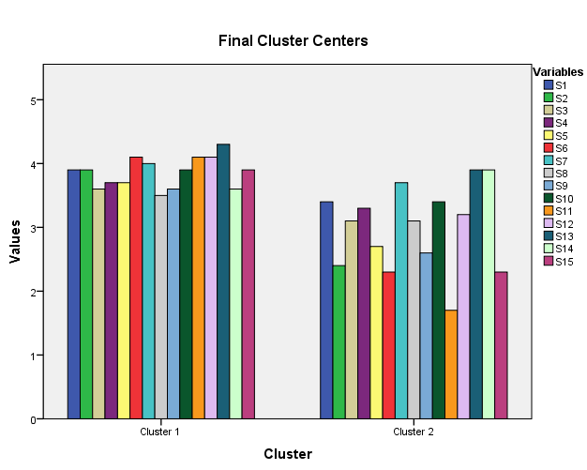
Final Clusters- Bar Chart for both Clusters

Slide 32
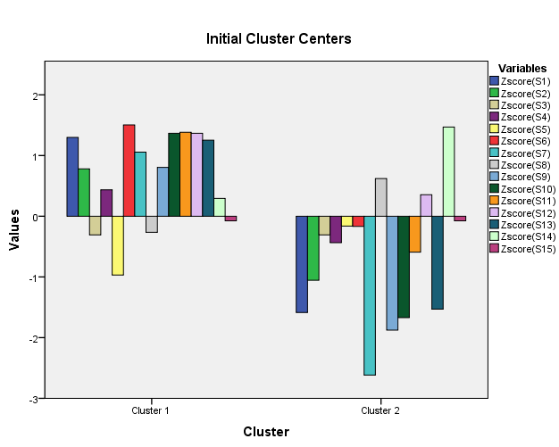
Final Clusters- Bar Chart for both Clusters on Z-score

Slide 33
Number of Cases in each Clusters
Number of Cases in each Cluster
Cluster | 1 | 10.000
 | 2 | 10.000
Valid |  | 20.000
Missing |  | .000

Slide 34
Cluster 1 Negligent Respondents
I feel foreign made products are always superior in quality.
I prefer to pay by credit card as a matter of continence.
A computer is a necessity rather than a luxury.
The liberalization of the Indian Economy has increased the efficiency of Indian Companies.
I prefer old Hindi songs than latest ones
I feel vegetarian food is more nutritious than non-vegetarian food.
I enjoy surfing on the net.
Television is has become an integral part of urban life.
Women’s education is an important aspect for the overall development of the country.
A movie is a major source of entertainment.
People are more conscious about quality of product
I believe the economic status of India will improve.
I prefer readymade cloths to tailored cloths
I Prefer to take my food outside every weekend.
Basic Computer education should be included in primary education level of India
Q2 | Q6 | Q9 | Q11 | Q12 | Q15
2.40 | 2.30 | 2.60 | 1.70 | 3.20 | 3.00

Slide 35
Cluster 2 Knowledgeable Respondents
I feel foreign made products are always superior in quality.
I prefer to pay by credit card as a matter of continence.
A computer is a necessity rather than a luxury.
The liberalization of the Indian Economy has increased the efficiency of Indian Companies.
I prefer old Hindi songs than latest ones
I feel vegetarian food is more nutritious than non-vegetarian food.
I enjoy surfing on the net.
Television is has become an integral part of urban life.
Women’s education is an important aspect for the overall development of the country.
A movie is a major source of entertainment.
People are more conscious about quality of product
I believe the economic status of India will improve.
I prefer readymade cloths to tailored cloths
I Prefer to take my food outside every weekend.
Basic Computer education should be included in primary education level of India
Q2 | Q6 | Q9 | Q11 | Q12 | Q15
3.90 | 4.10 | 3.60 | 4.10 | 4.10 | 3.90

Slide 36
Clusters
Cluster 1
10 Member
1,4,5,6,10,11,12,13,19,20
Cluster 2
10 Members
2,3,7,8,9,14,15,16,17,18

Slide 37
Thank You

Slide 38
Case Study: 2
We consider a clustering of customers based on attitudes towards shopping . Based on past research, six attitudinal variables were identified . Customers were asked to express their degree of agreement with the following statements on 7-points scale
1= Strongly Disagree, 2 =Disagree, 3= Neither Agree Nor Disagree, 4= Agree, 5= Strongly Agree

Slide 39
Topic:
A study of segmentation of customers in terms of their attitude towards shopping.

Slide 40
Objectives
To study the variables of attitude of customers towards shopping.
To segment the customers on the basis of their attitude towards shopping.

Slide 41
Questions
Q1. I love to buy products in shopping mall.
Q2. I buy discounted products
Q3. I enjoy eating food at Shopping Mall.
Q4. I bargain products when shopping
Q5. I buy only daily need products
Q6. I compare prices of products in shopping mall.

Slide 42
Data and Data Analysis

Slide 43
Case Processing Summary
Case Processing Summary^{a,b}
Cases
Valid |  | Missing |  | Total
N | Percent | N | Percent | N | Percent
25 | 100.0 | 0 | 0.0 | 25 | 100.0
a. Squared Euclidean Distance used
b. Ward Linkage

Slide 44
Agglomeration Schedule
Agglomeration Schedule
Stage | Cluster Combined |  | Coefficients | Stage Cluster First Appears |  | Next Stage
 | Cluster 1 | Cluster 2 |  | Cluster 1 | Cluster 2
1 | 14 | 16 | 1.000 | 0 | 0 | 6
2 | 6 | 7 | 2.000 | 0 | 0 | 8
3 | 11 | 25 | 3.500 | 0 | 0 | 12
4 | 8 | 23 | 5.000 | 0 | 0 | 16
5 | 13 | 22 | 6.500 | 0 | 0 | 19
6 | 10 | 14 | 8.167 | 0 | 1 | 9
7 | 4 | 9 | 10.167 | 0 | 0 | 12
8 | 6 | 21 | 12.500 | 2 | 0 | 10
9 | 10 | 24 | 15.083 | 6 | 0 | 13
10 | 6 | 12 | 18.000 | 8 | 0 | 15
11 | 1 | 17 | 21.500 | 0 | 0 | 15
12 | 4 | 11 | 25.250 | 7 | 3 | 17
13 | 10 | 19 | 30.000 | 9 | 0 | 21
14 | 5 | 20 | 35.500 | 0 | 0 | 17
15 | 1 | 6 | 41.083 | 11 | 10 | 20
16 | 2 | 8 | 46.917 | 0 | 4 | 20
17 | 4 | 5 | 55.500 | 12 | 14 | 19
18 | 3 | 18 | 65.000 | 0 | 0 | 21
19 | 4 | 13 | 77.042 | 17 | 5 | 23
20 | 1 | 2 | 89.264 | 15 | 16 | 22
21 | 3 | 10 | 104.907 | 18 | 13 | 23
22 | 1 | 15 | 122.218 | 20 | 0 | 24
23 | 3 | 4 | 221.267 | 21 | 19 | 24
24 | 1 | 3 | 406.720 | 22 | 23 | 0

Slide 45
Cluster Membership
Cluster Membership
Case | 4 Clusters | 3 Clusters | 2 Clusters
1 | 1 | 1 | 1
2 | 1 | 1 | 1
3 | 2 | 2 | 2
4 | 3 | 3 | 2
5 | 3 | 3 | 2
6 | 1 | 1 | 1
7 | 1 | 1 | 1
8 | 1 | 1 | 1
9 | 3 | 3 | 2
10 | 2 | 2 | 2
11 | 3 | 3 | 2
12 | 1 | 1 | 1
13 | 3 | 3 | 2
14 | 2 | 2 | 2
15 | 4 | 1 | 1
16 | 2 | 2 | 2
17 | 1 | 1 | 1
18 | 2 | 2 | 2
19 | 2 | 2 | 2
20 | 3 | 3 | 2
21 | 1 | 1 | 1
22 | 3 | 3 | 2
23 | 1 | 1 | 1
24 | 2 | 2 | 2
25 | 3 | 3 | 2

Slide 46
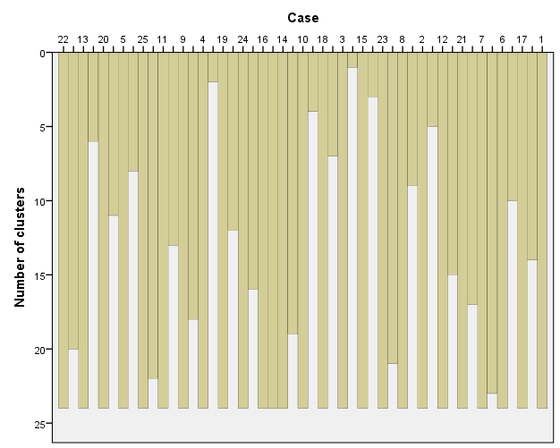
Graphical Representation

Slide 47
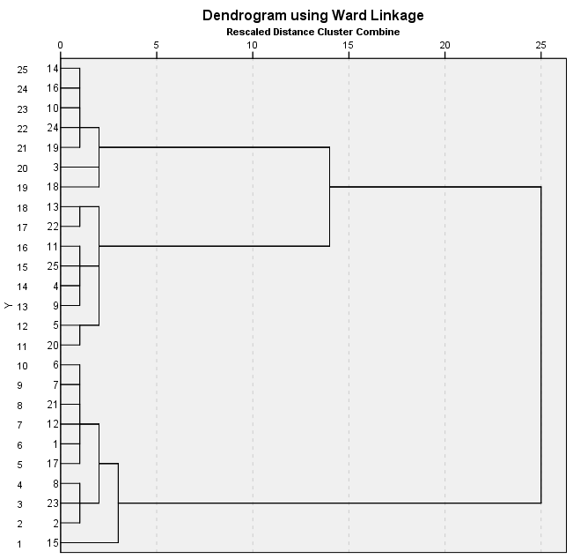
Dendrogram

Slide 48
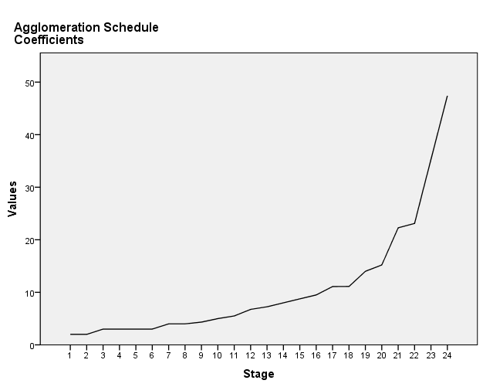
Elbow Method For Number of Clusters (No of clusters =No. of cases-elbow point)

Slide 49
Iteration History
Iteration Historyª
Iteration | Change in Cluster Centers
 | 1 | 2 | 3
1 | 2.125 | 2.475 | 2.257
2 | 0.000 | .439 | .656
3 | 0.000 | 0.000 | 0.000
a. Convergence achieved due to no or small change in cluster centers. The maximum absolute coordinate change for any center is .000. The current iteration is 3. The minimum distance between initial centers is 7.746.

Slide 50
Non –Hierarchal Clusters Analysis (K-Means Cluster Analysis)
Initial Cluster Centers
 | Cluster
 | 1 | 2 | 3
Q1. I love to buy products in shopping mall | 2 | 7 | 4
Q2. I buy discounted products | 3 | 2 | 6
Q3. I enjoy eating food at Shopping Mall. | 2 | 6 | 3
Q4. I bargain products when shopping | 4 | 4 | 7
Q5. I buy only daily need products | 7 | 1 | 2
Q6. I compare prices of products in shopping mall. | 2 | 3 | 7

Slide 51
Cluster Membership
Cluster Membership
Case Number | Cluster | Distance
1 | 2 | 1.944
2 | 2 | 2.232
3 | 3 | 2.924
4 | 1 | 2.004
5 | 1 | 2.875
6 | 2 | 1.334
7 | 2 | 1.476
8 | 2 | 2.093
9 | 1 | 1.329
10 | 3 | 1.355
11 | 1 | 1.329
12 | 2 | 1.838
13 | 1 | 2.831
14 | 3 | 1.726
15 | 2 | 3.947
16 | 3 | 1.884
17 | 2 | 2.404
18 | 3 | 3.482
19 | 3 | 2.167
20 | 1 | 2.125
21 | 2 | 1.783
22 | 1 | 1.586
23 | 2 | 2.680
24 | 3 | 1.187
25 | 1 | 2.004

Slide 52
Final Cluster Centers
Final Cluster Centers
 | Cluster
 | 1 | 2 | 3
Q1. I love to buy products in shopping mall | 2 | 6 | 3
Q2. I buy discounted products | 3 | 3 | 6
Q3. I enjoy eating food at Shopping Mall. | 2 | 6 | 3
Q4. I bargain products when shopping | 4 | 3 | 6
Q5. I buy only daily need products | 6 | 2 | 3
Q6. I compare prices of products in shopping mall. | 3 | 4 | 6

Slide 53
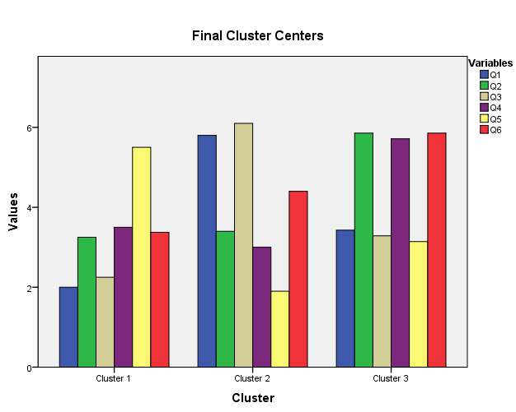
Final Clusters- Bar Chart for all three Clusters

Slide 54
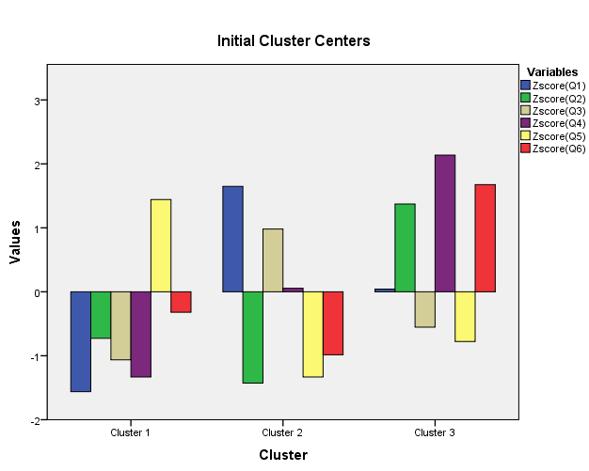
Final Clusters- Bar Chart for all three Clusters on Z-score

Slide 55
ANOVA Table
ANOVA
 | Cluster |  | Error |  | F | Sig.
 | Mean Square | df | Mean Square | df
Q1. I love to buy products in shopping mall | 33.263 | 2 | .787 | 22 | 42.265 | .000
Q2. I buy discounted products | 16.101 | 2 | .762 | 22 | 21.139 | .000
Q3. I enjoy eating food at Shopping Mall. | 36.006 | 2 | .901 | 22 | 39.949 | .000
Q4. I bargain products when shopping | 16.206 | 2 | .792 | 22 | 20.456 | .000
Q5. I buy only daily need products | 29.121 | 2 | .898 | 22 | 32.427 | .000
Q6. I compare prices of products in shopping mall. | 11.554 | 2 | 1.415 | 22 | 8.165 | .002
The F tests should be used only for descriptive purposes because the clusters have been chosen to maximize the differences among cases in different clusters. The observed significance levels are not corrected for this and thus cannot be interpreted as tests of the hypothesis that the cluster means are equal.

Slide 56
Cluster 1- Passive Customers
Q1. I love to buy products in shopping mall
Low Value- 2
Q2. I buy discounted products
Low value -3
Q3. I enjoy eating food at Shopping Mall
Low Value-2
Q4. I bargain products when shopping
Average Value -4
Q5. I buy only daily need products
High value 6
Q6. I compare prices of products in shopping mall.
Low Value -3
Q1 | Q2 | Q3 | Q4 | Q5 | Q6
2 | 3 | 2 | 4 | 6 | 3

Slide 57
Cluster 2: Enjoy loving Customers
Q1. I love to buy products in shopping mall
High Value- 6
Q2. I buy discounted products
Low Value -3
Q3. I enjoy eating food at Shopping Mall
High Value-6
Q4. I bargain products when shopping
Low Value -3
Q5. I buy only daily need products
Low value 2
Q6. I compare prices of products in shopping mall.
Average value -4
Q1 | Q2 | Q3 | Q4 | Q5 | Q6
6 | 3 | 6 | 3 | 2 | 4

Slide 58
Cluster 3- Economical Buyers
Q1. I love to buy products in shopping mall
Low Value -3
Q2. I buy discounted products
High Value-6
Q3. I enjoy eating food at Shopping Mall
Low Value -3
Q4. I bargain products when shopping
High Value-6
Q5. I buy only daily need products
Low Value -3
Q6. I compare prices of products in shopping mall
High value-6
Q1 | Q2 | Q3 | Q4 | Q5 | Q6
3 | 6 | 3 | 6 | 3 | 6

Slide 59
Distances between Final Cluster Centers
Distances between Final Cluster Centers
Cluster | 1 | 2 | 3
1 |  | 6.599 | 5.151
2 | 6.599 |  | 5.533
3 | 5.151 | 5.533

Slide 60
Clusters
Cluster 1
8 Members
4,5,9,11,13,20,22,25
Cluster 2
10 Members
1,2,6,7,8,12,15,17,21,23
Cluster 3
7 Members
3,10,14,16,18,19,24

Slide 61
Cluster Analysis in SPSS
After the input data has been typed along with variable labels in SPSS file, to get the output for a Cluster Analysis problem similar to that described in the text,
Stage 1
Click on ANALYZE at the SPSS menu bar (in older versions of SPSS, click on STATISTICS instead of ANALYZE).
Click on CLASSIFY, followed by HIERARCHICAL CLUSTER
On the dialogue box which appears, select all the variables required for the cluster analysis by clicking on the right arrow to transfer them from the variables list on the left to the variables box on the right. Then under the small section called “Cluster” , select CASES because you usually would be clustering cases (rows of data which normally are the respondents or objects to be grouped into clusters). In another small box called “DISPLAY” ,select (tick indicates selection)” Statistics” and “Plots”.
Click on METHOD . In the dialogue box which will open up, choose “Between Groups Linkage” as the CLUSTERING METHOD . In the box titled “Measure” choose “Squared Euclidean Distance”
Click CONTINUE to return to the main dialogue box.
Click STATISTICS on the main dialogue box. Choose “Agglomeration Schedule” so that it will appear in the final output. Click CONTINUE.
Click PLOTS on the main dialogue box. Choose DENDROGRAM . Then on the box called ICICLE, Choose “All Clusters” and “Vertical”. This will get you all the required plots on the output. Click CONTINUE to return to the main dialogue box.
Click OK on the main dialogue box to get the output of the HIERARCHICAL CLUSTER ANALYSIS.

Slide 62
Continued..
Stage 2
After the number of clusters has been identified using hierarchical cluster analysis , you can proceed to the second stage recommended . This stage is known as K-MEANS CLUSTERING.(Quick Clustering)
Click CLASSIFY , followed by K-MEANS CLUSTER.
Fill the desired number of clusters you have identified from stage 1.
Click OPTIONS on the main dialogue box. Select “Initial Cluster centers” “ANOVA Table” and “Cluster Information for each case” in the box labeled STATISTICS. Then click CONTINUE to return to the main dialogue box.
Click OK on the main dialogue box to get the output which contains the final cluster Centers from K-Means clustering method described in the text.

Slide 63
Thank You

